Slide 1
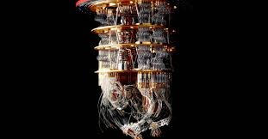


NTU-IBM Q System 2020 Q-Camp
Predicting molecules ground state energies and handwriting recognition with parametrized quantum circuit by using
and
Group members: 郭庭愷、劉峻瑋、張中瀚、高魁駿、李孟璋
Coach: 蔡沛愷

Slide 2
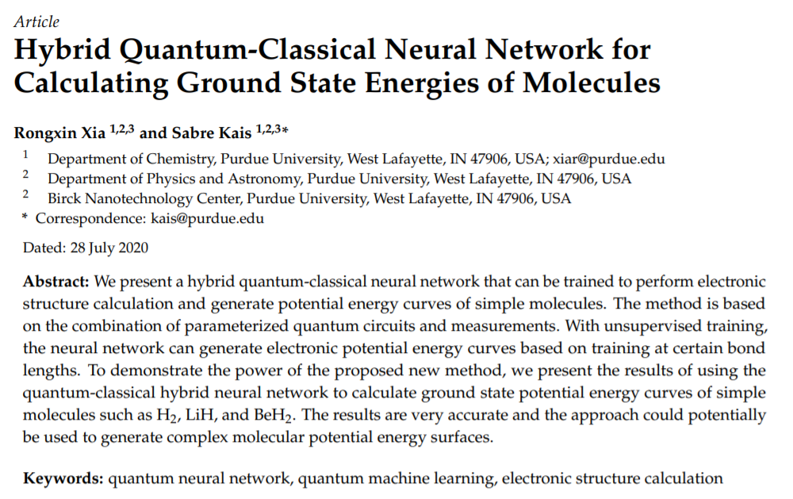
Reference
It combines the VQC and classical neural network
The qiskit official documentation : https://qiskit.org/textbook/ch-machine-learning/machine-learning-qiskit-pytorch.html
The metalearner using quantum circuit+LSTM:
https://github.com/BoschSamuel/QizGloria/tree/master/Notebooks

Slide 3
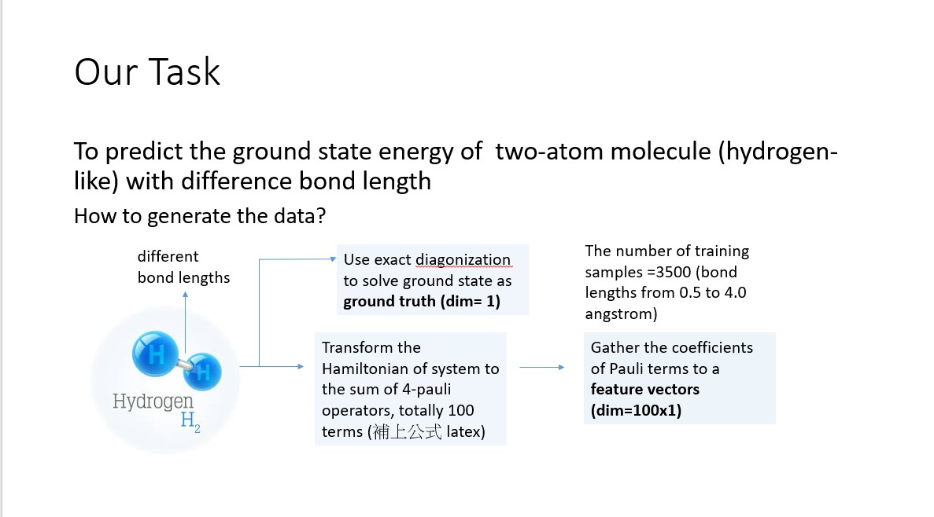
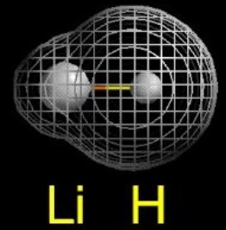
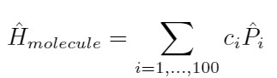
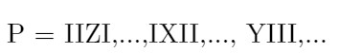
LiH molecule
...

Slide 4
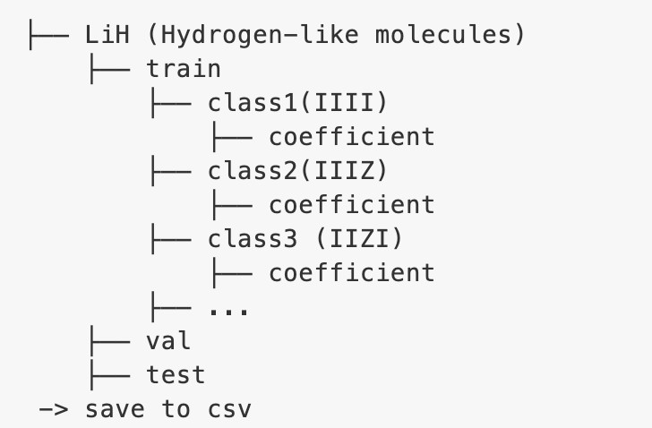
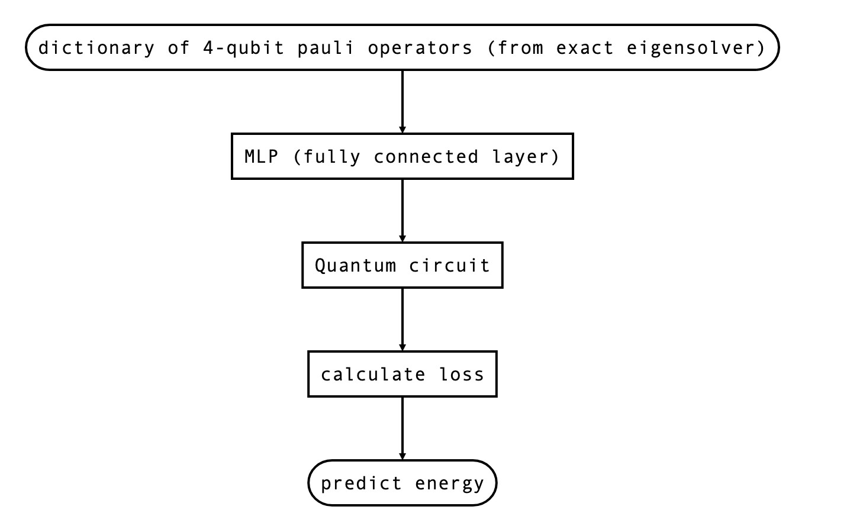
Flow and Data Structure

Slide 5
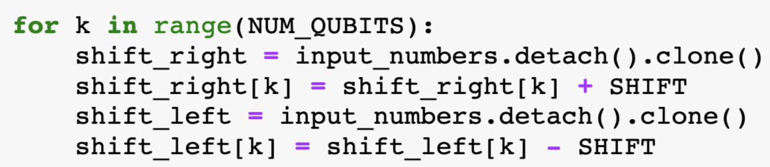
AQGD Code Snippet
Ref:
Valuating analytic gradient on quantum hardware, PRA 99,032331 (2019)

Slide 6
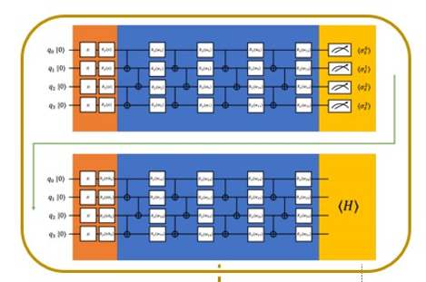
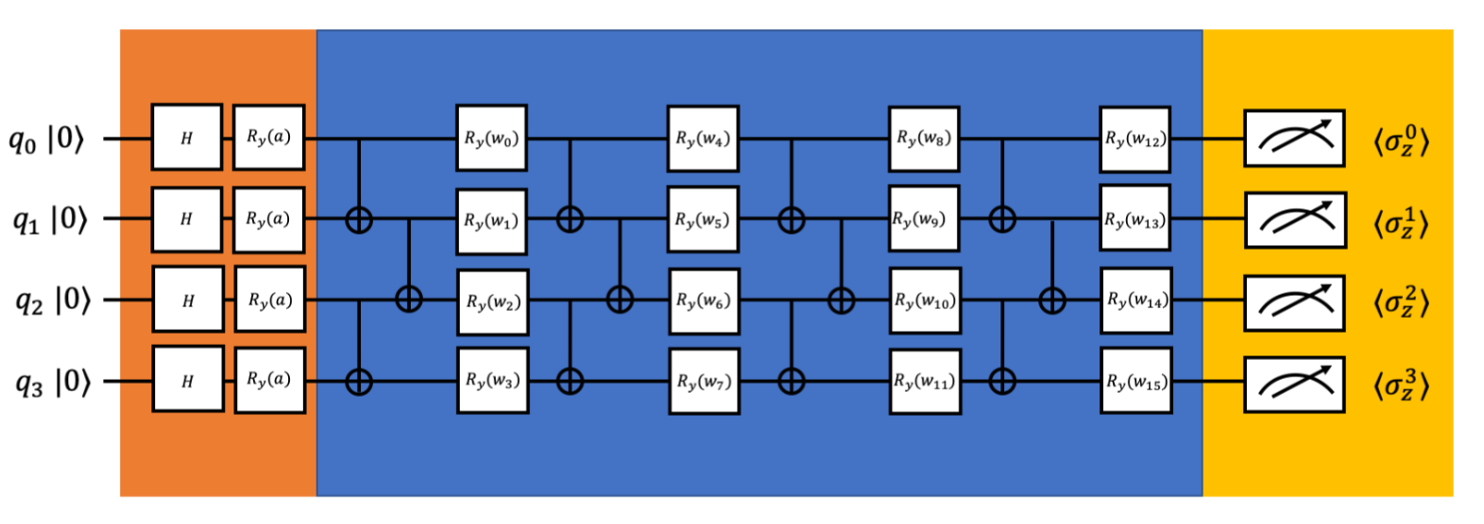
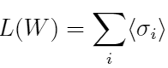
Parametrized Quantum Circuit (PQC)
Recall:
We changed our plan and focus on the quantum block of original model
Loss function: sum of expectation
W’
Optimizer: AQGD

Slide 7
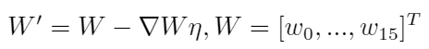
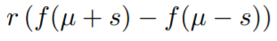
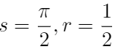
PQC+AQGD
If we only use the single-qubit rotation gate in the VQE,
We can exactly derive the gradient of loss function by AQGD
formulation rather than approximated gradient.

Slide 8
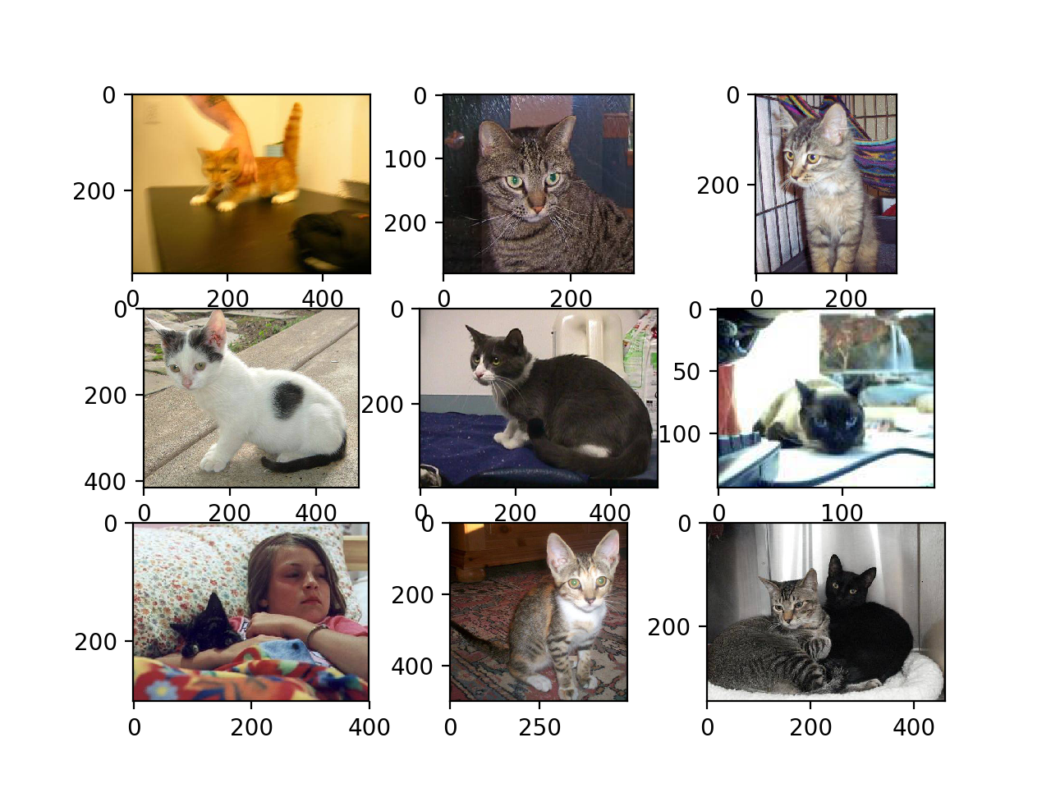
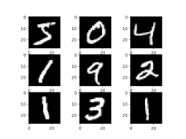
We also apply model to the MNIST and Dog-and-Cat dataset

Slide 9
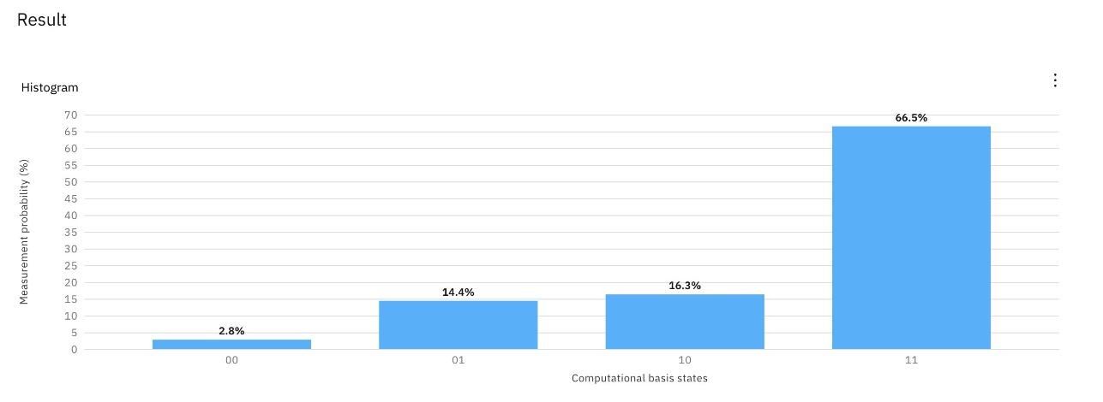
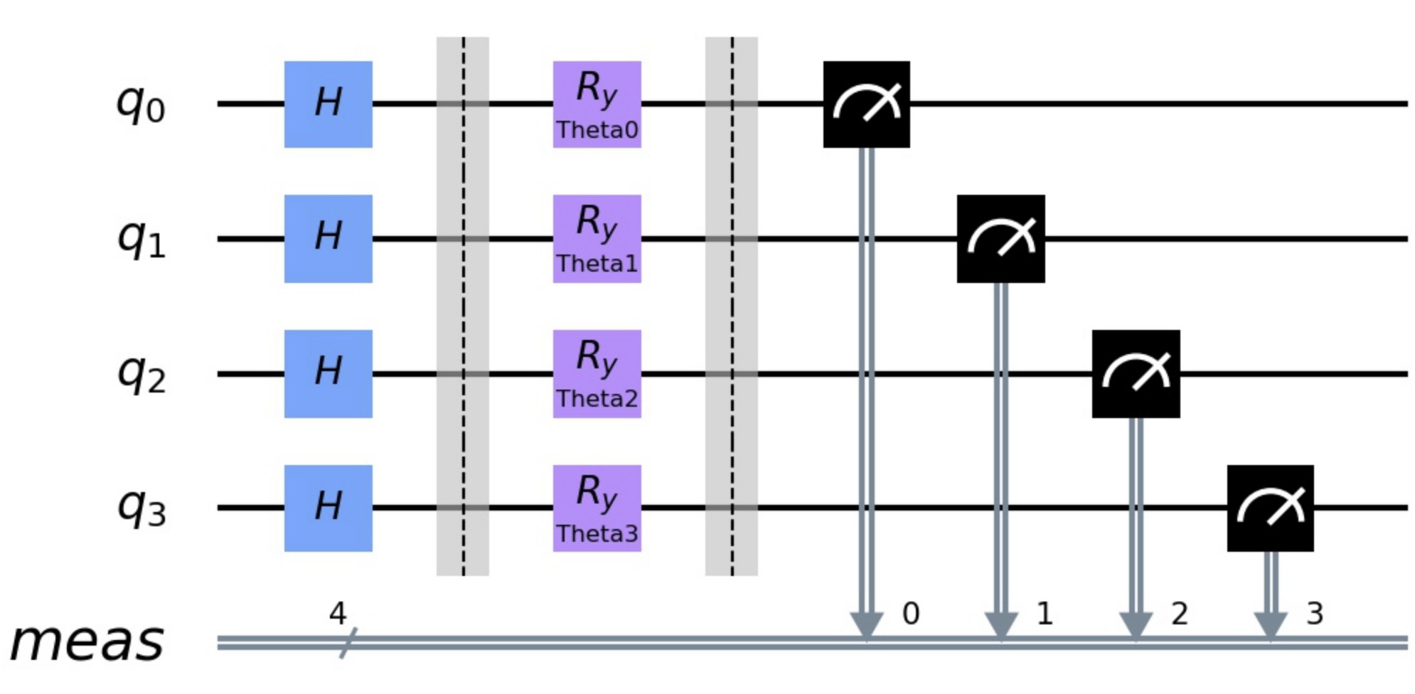
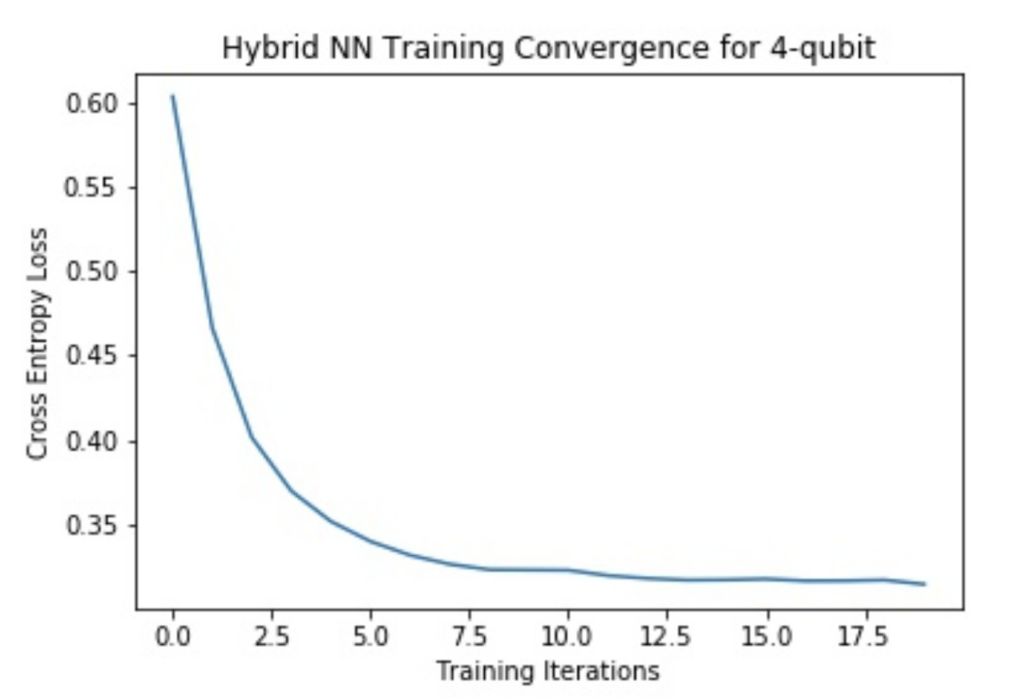
RyN: apply Hadamard gates and Ry gates to N-qubit and measure the qubits

Slide 10
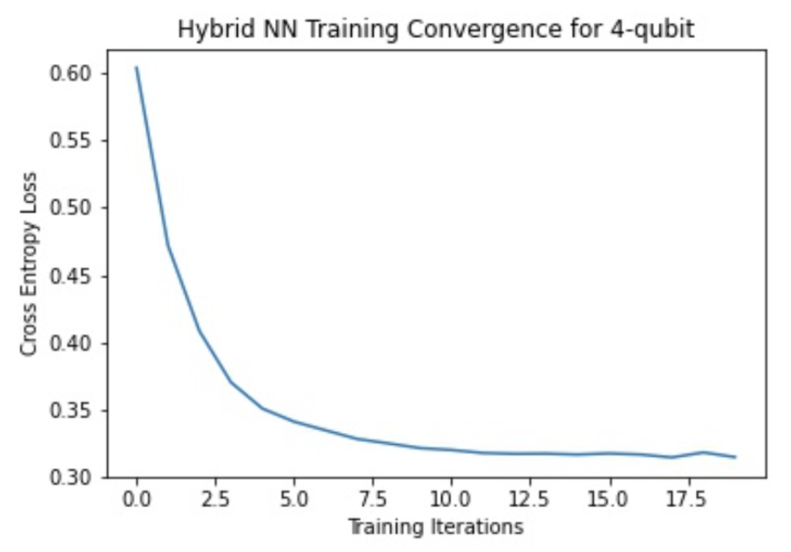
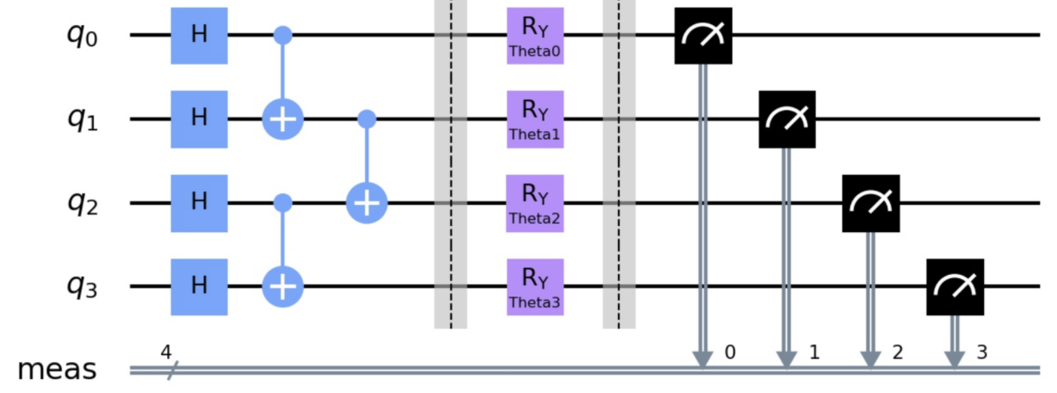
Ladder Circuit(Using staggered CNOT gates to make more entangled)
The original circuit block

Slide 11
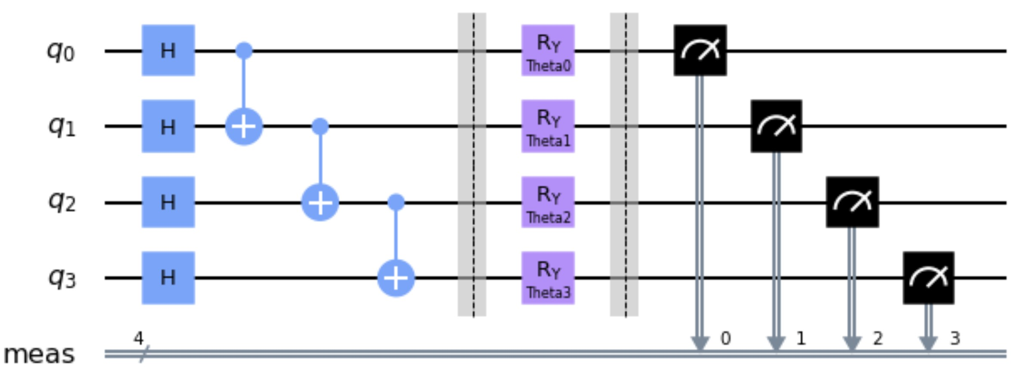
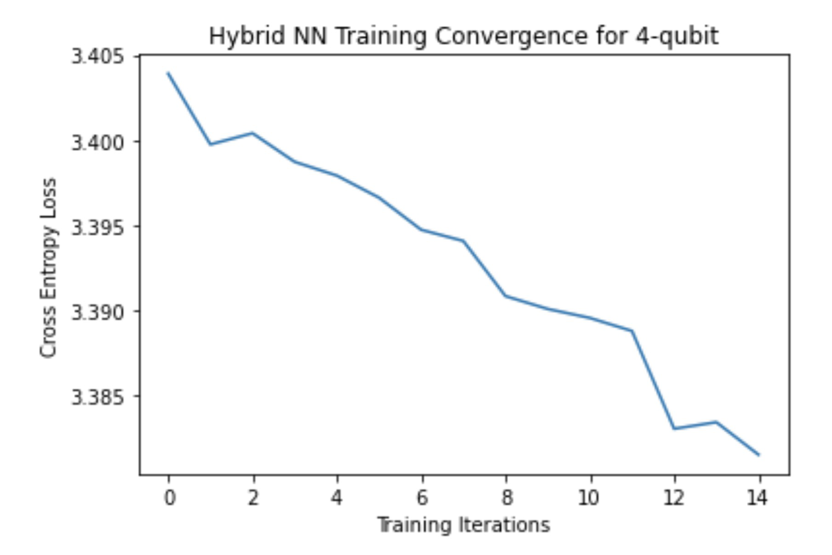
The GHZ version

Slide 12
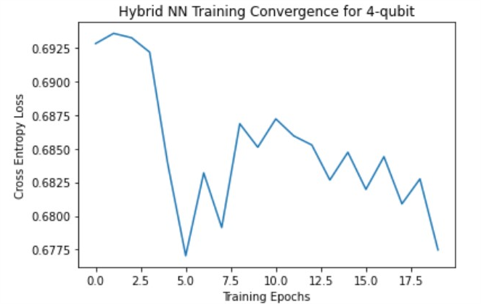
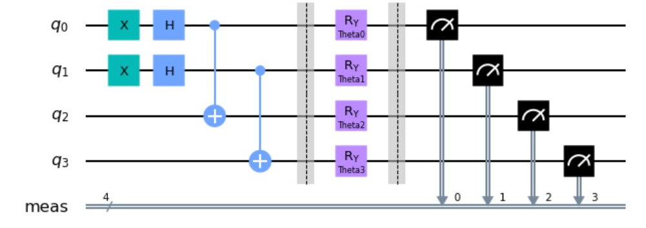
Sub-block of MPS-inspired ansatz

Slide 13
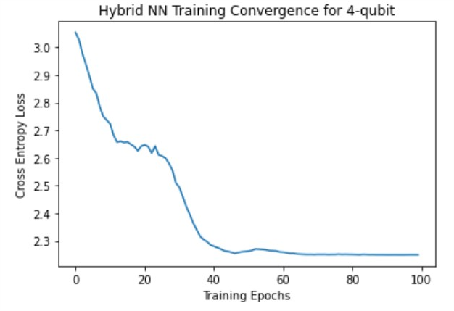
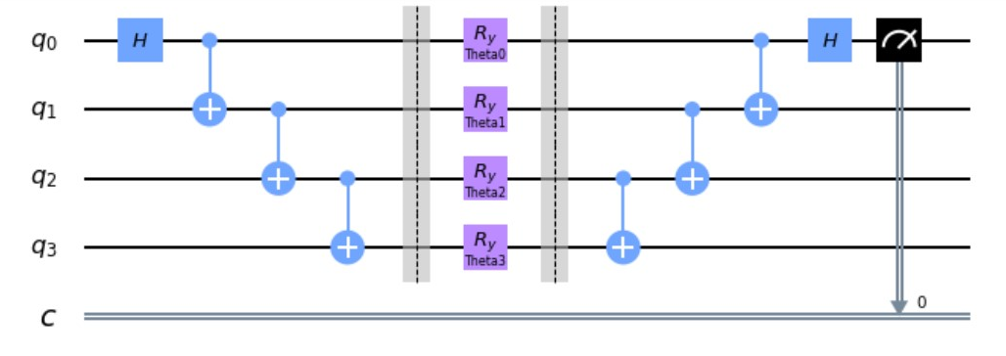
Bell state

Slide 14
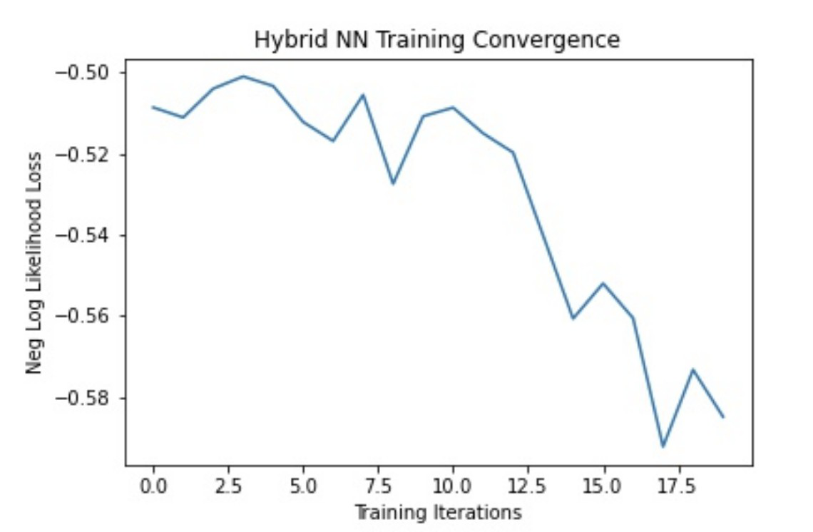
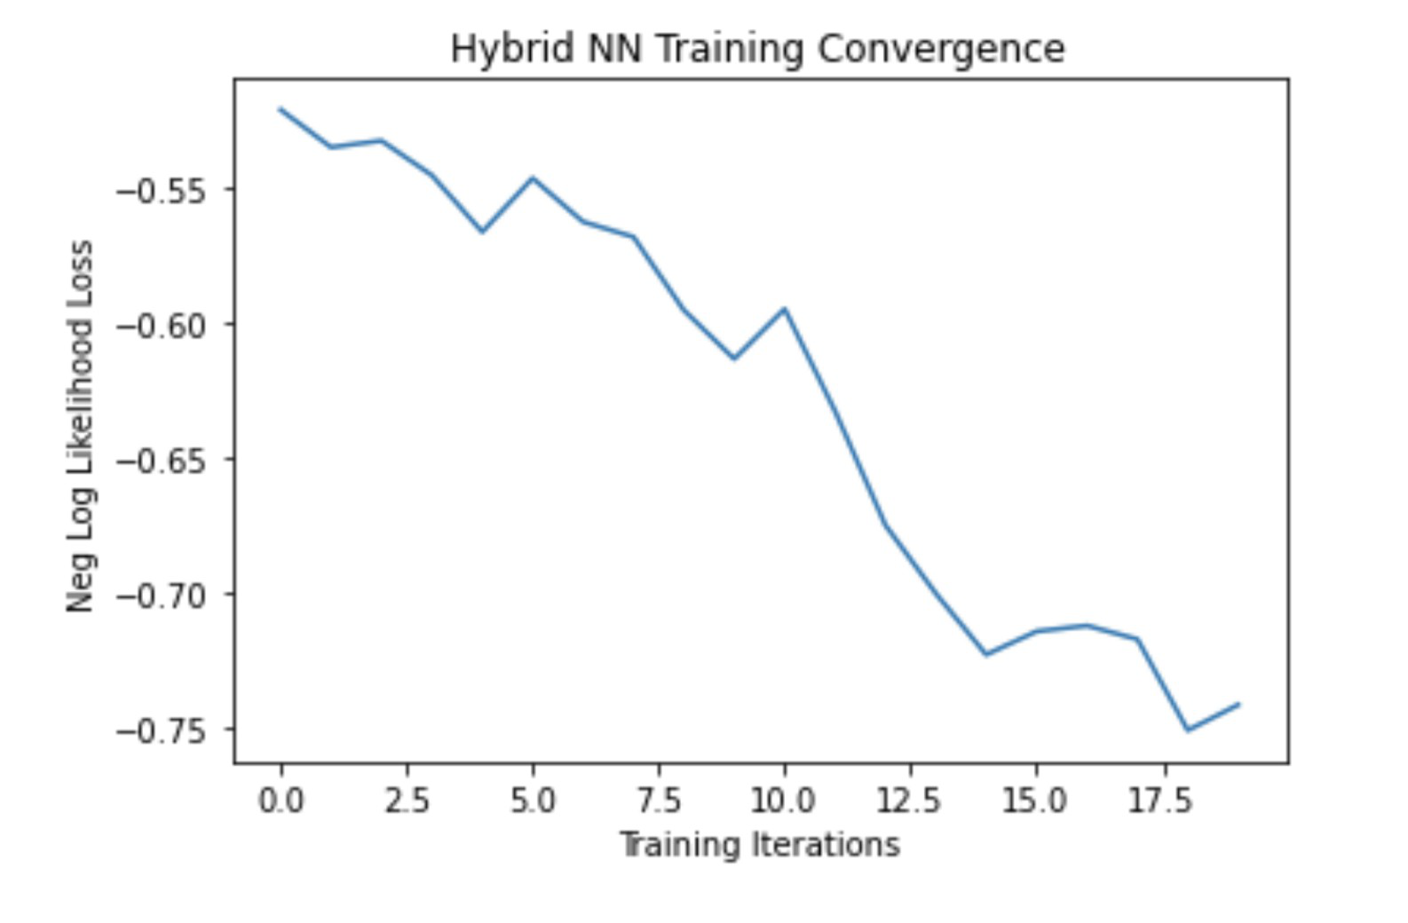
U3(unitary operation to three phase angles) gate run on MNIST dataset
Run on CPU, Accuracy: 75%
Run on GPU, Accuracy: 87%

Slide 15
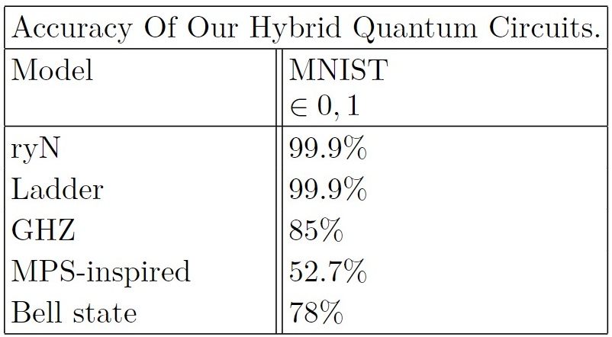
Accuracy Comparison Between Difference RyN Gates Circuit

Slide 16
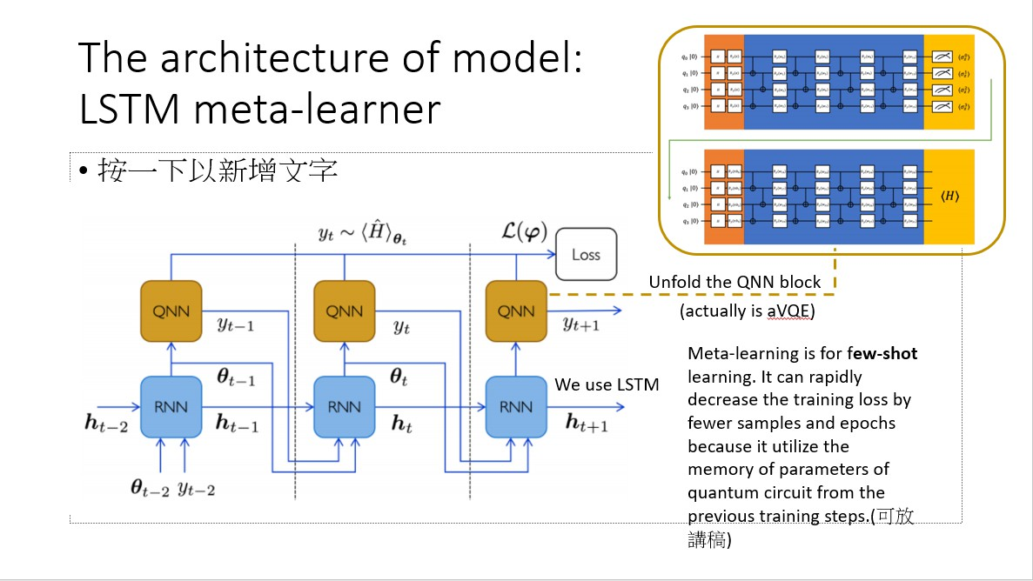
In Progress
It was our original plan. But we met the runtime problem
in the back-propagation step.

Slide 17
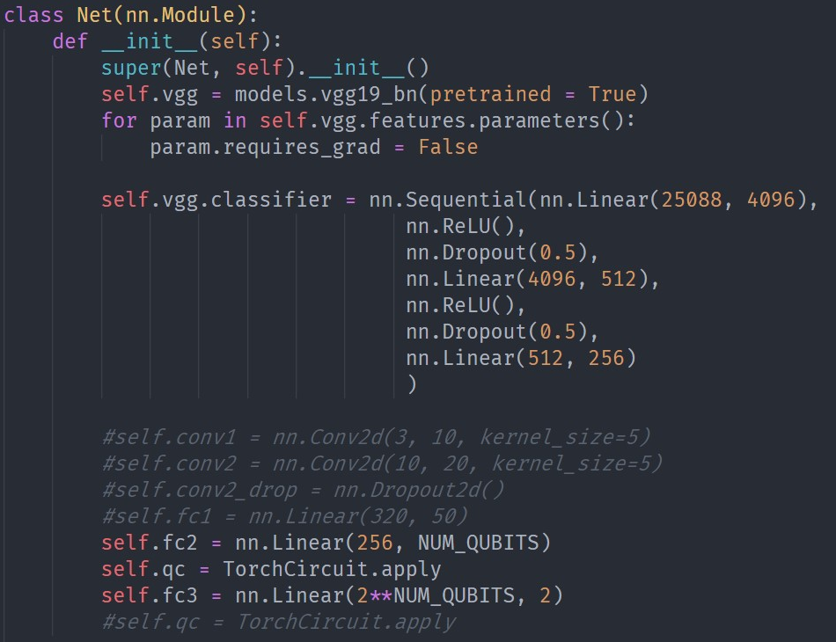
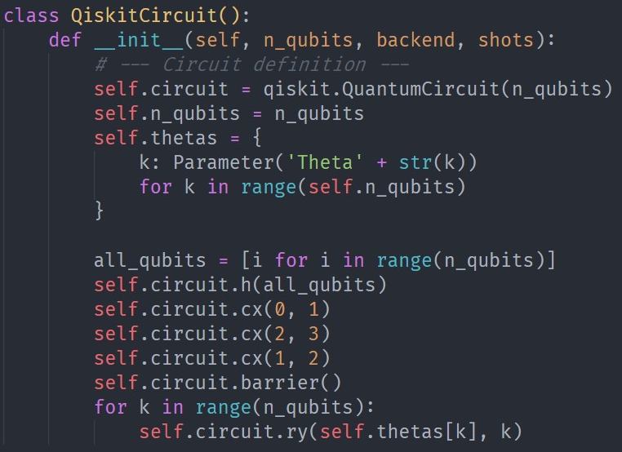
In Progress: Code Cat&Dog

Slide 18
Summaries
It seems sequential entanglement, exhibiting more benenificial to converge loss than that in long range one.
more entaglement, more powerful
Explaination: if only product state in the circuit， it is more similar to separately predict the bit of the binary representation of 0~9 rather than the whole number.

Slide 19
In The Future
Implement hybrid neural network model with VQE to predict the ground state energy of different hydrogen-like molecules.(in progress)
Try training our neural nets on the actual IBM machine (have attempted)
Compare results from an actual hardware with that from the simulator
Implement different image dataset on complex classical model + quantum circuit (in progress)

Slide 20
Thanks for your listening!

